Slide 1
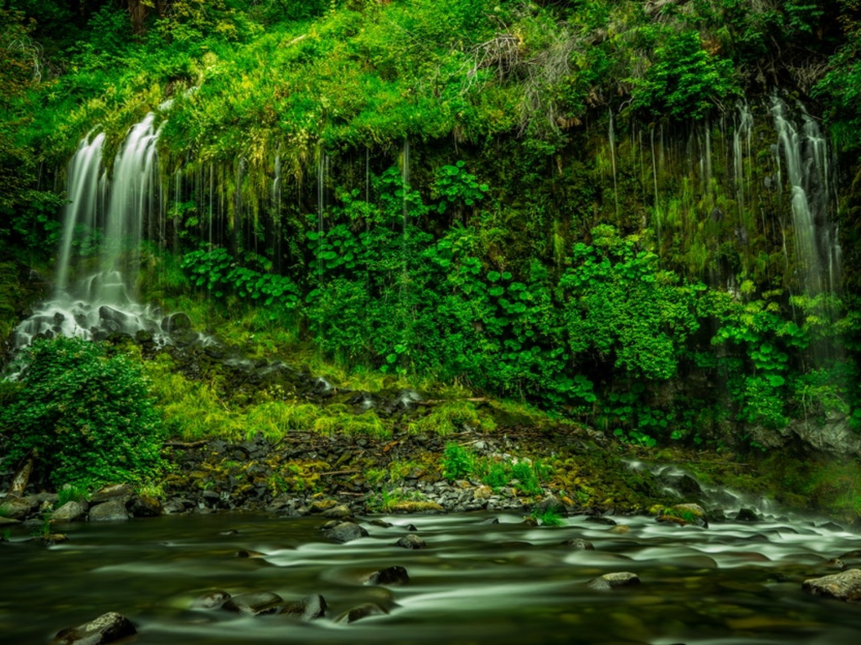
WATER RESOURCE

Slide 2
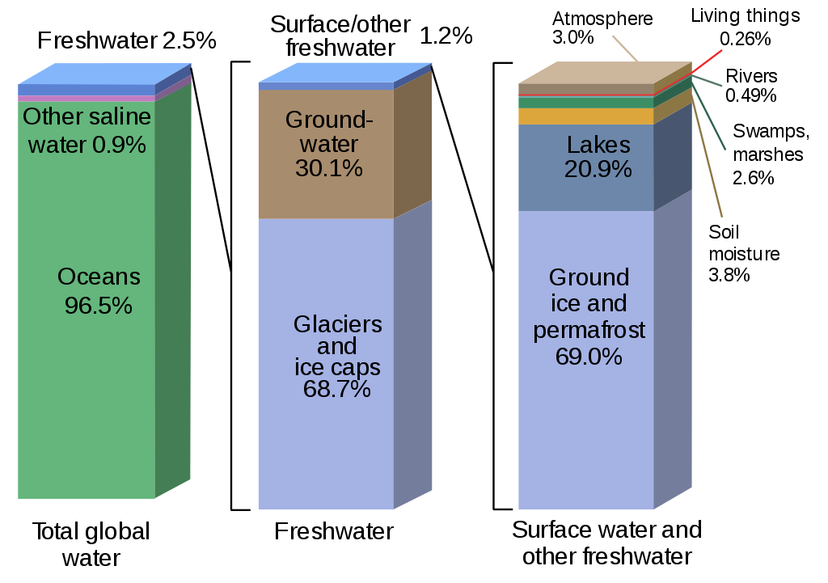
Water Resources
Water availability

Slide 3
Properties of water and its effects
It has the highest specific heat, due to which it warms up and cools down very slowly without causing shocks of temperature jerks to the aquatic life.
It has a high latent heat of vaporization Hence, it takes a huge amount of energy for getting vaporized. That’s why it produces a cooling effect as it evaporates.
It is an excellent solvent for several nutrients. Thus, it can serve as a very good carrier of nutrients, including oxygen, which are essential for life. But, it can also easily dissolve various pollutants and become a carrier of pathogenic microorganisms.
Due to high surface tension and cohesion it can easily rise through great heights through the trunk.
It has an anamolous expansion behaviour. It is because of this property that even in extreme cold, the lakes freeze only on the surface. Being lighter the ice keeps floating, whereas the bottom waters remain at a higher temperature and therefore, can sustain aquatic organisms even in extreme cold.

Slide 4
Importance of water
Water is the basic component of every living cell.
Water is one of the input required for agriculture.
Industries consume water for cooling, heating and other processes.
Electricity generation
Waterways are used for inland transport.
Water may be used for obtaining common salt.
Water provides habitat to aquatic flora and fauna.

Slide 5
Water usage
Agriculture – 70%, Municipal – 11%, Industrial – 19%
Average requirement is 20 – 40 liter per head per day (Twice of the usage 50 years ago)
About 30% of fresh water is used by US (4% of world population) where, middle east (5% of world population use 1% of fresh water).
More than 1 billion people don’t have fresh water supply.
Presently 31 countries facing water scarcity.
By 2025, 48 countries will face water shortage (including India).
By 2050, 4 billion people will suffer water shortage.

Slide 6
Conflict over water
Tigris and Euphrates conflict (Turkey – Syria – Iraq)
Nile conflict (Egypt – Ethiopia – Sudan)
Jordon river conflict (Israel - Lebanon – Jordon – Palestine)
Aral sea conflict (Kazakhstan – Uzbekistan – Tajikistan – Turkmenistan)
Indus water treaty (Jhelum - Chenab: Pakistan, Satluj, Ravi, Beas: India)
Kaveri dispute
  Origins in brahmagiri hill (Karnataka)
  Then enters Tamil Nadu
  First agreement in 1892
  Mettur dam was built in 1970 – Tamil Nadu raised objection
  1991 a tribunal is formed – Karnatake opposed
Satluj-Yamuna Link (SYL) canal dispute (Punjab – Haryana)

Slide 7
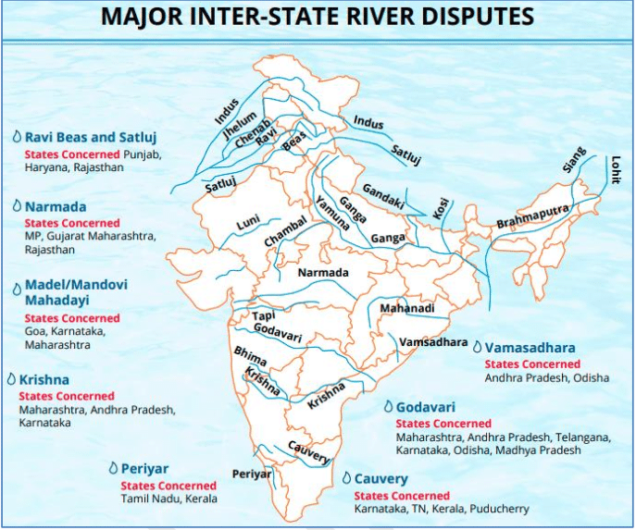

Slide 8
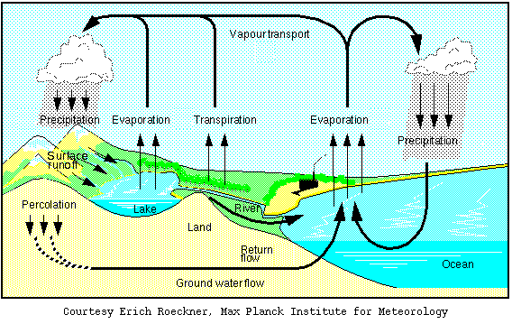
Water cycle

Slide 9
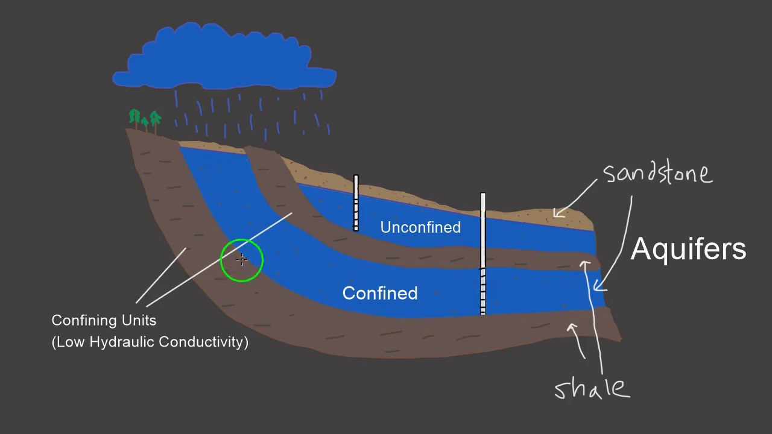
Source of water
Surface water
  Rainfall, snow
Ground water
  Confined aquifer
  Unconfined aquifer
Aquifer
  An aquifer is a body of rock and/or sediment that holds groundwater. Groundwater is the word used to describe precipitation that has infiltrated the soil beyond the surface and collected in empty spaces underground. It can move through the aquifer and resurface through springs and wells.

Slide 10
Unconfined aquifers are where the rock is directly open at the surface of the ground and groundwater is directly recharged, for example by rainfall or snow melt.
Confined aquifers are where thick deposits overly the aquifer and confine it from the Earth's surface or other rocks.

Slide 11
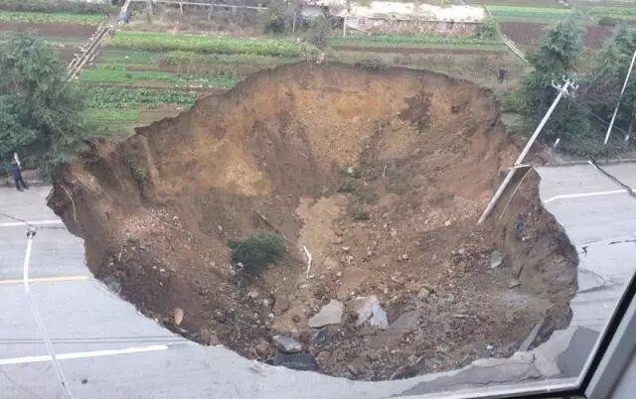
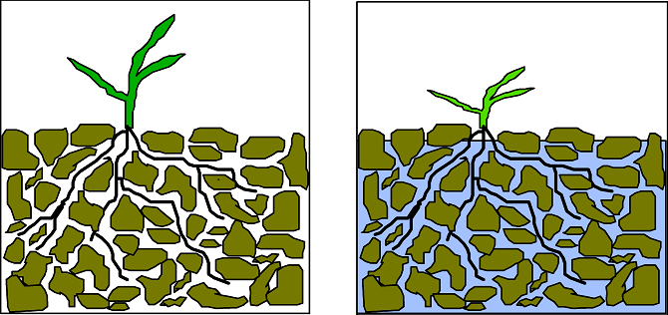
Over exploitation of ground water
Ground subsidence
Lowering water table
Reduced surface water flow
Increased power consumption
Water logging
Ground water pollution

Slide 12
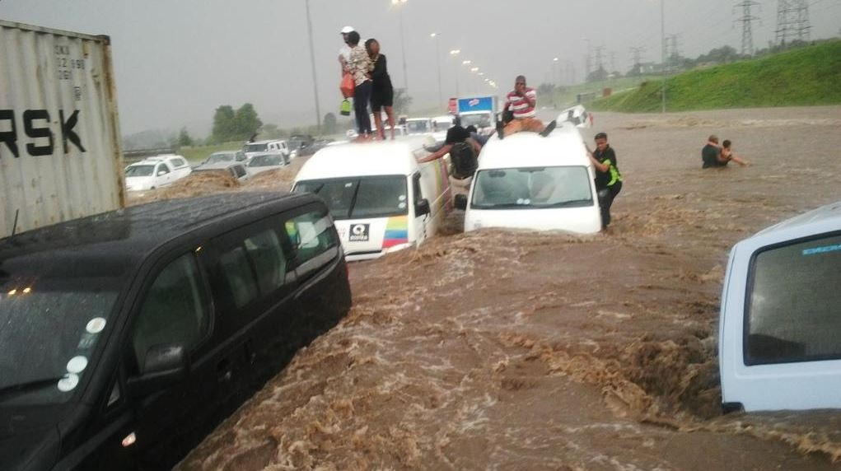
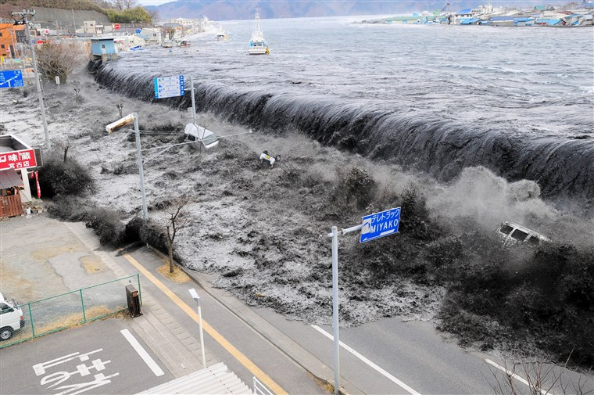
Water calamities (Flood)
Types
  Flash flood: Heavy rainfall, dam failure, river obstruction
  River flood: Precipitation over large catchment area, melting of snow
  Coastal flood: Hurricanes, tropical cyclone, tsunami
Causes
  Upslope factors
    Melting of snow
    Intense rainfall
    Time of concentration
  Downslope factors
    Dams and reservoirs
    Tides
    Natural events: Tsunami, Storm

Slide 13
Water calamities (Flood)
Effects
  Negative effects: Loss of life and property, damage to crops, damage to power transmission, water-borne diseases, difficulty in health facilities, decline in tourism
  Positive effects: Distribution of nutrients, relocation of fishes

Slide 14
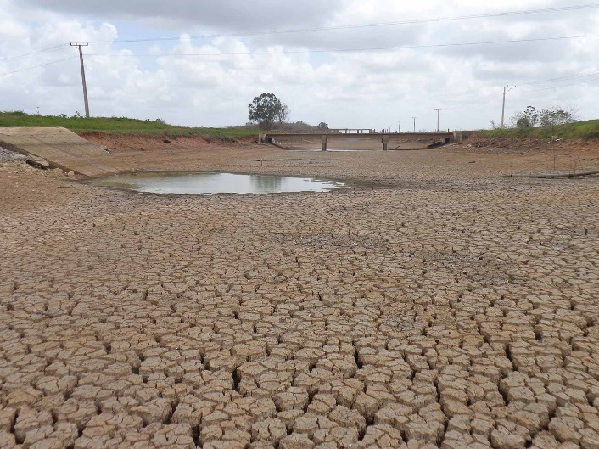
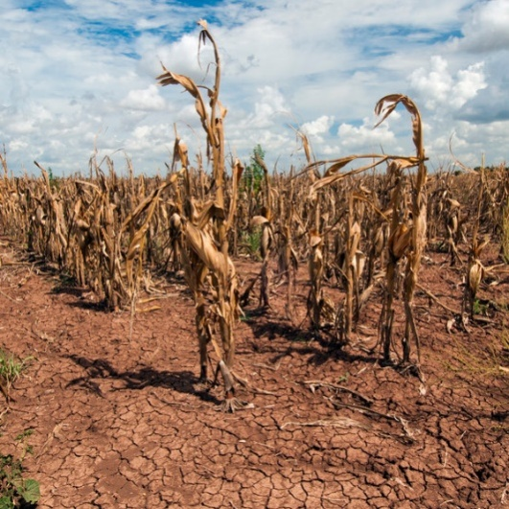
Water calamities (Drought)
Types
  Meteorological drought: Less rainfall
  Hydrological drought: Low stream flow (drying up of reservoirs, lakes, streams, rivers)
  Agricultural drought: Low soil moisture (Agricultural drought usually occurs when soil water availability to plants in a specific area has dropped to a level threshold)
Causes
  Dry season
  Climate change
  Erosion and human activity

Slide 15
Water calamities (Drought)
Effects
  Decrease in crop growth
  Dust storm
  Famine and mal nutrition
  Habitat change
  Mass migration
  Reduced electricity
  Wild fire

Slide 16
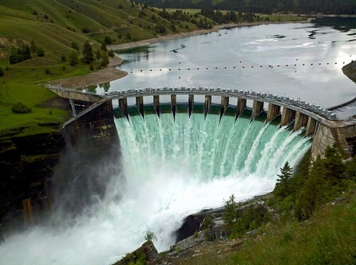
Dams
Benefits
  Electricity generation
  Employment
  Irrigation water supply
  Drinking water supply
  Reduction in famine
  Flood control

Slide 17
Dams
Problems
  Displacement of tribal people
  Loss of forest
  Changes in aquatic environment
  Waterlogging near reservoir
  Breeding of vectors
  Microclimatic changes
  Reduced water flow
  Flash flood
  Salt water intrusion
  Sediment carrying nutrients get deposited in reservoir.
  Outbreak of vector-borne diseases like malaria.

Slide 18
Practice Questions
Which property of water is incorrect among following options
a) the highest specific heat
b) Low latent heat of vaporization
c) high surface tension
d) anamolous expansion behaviour

Slide 19
SYL is a dispute between
a) India-Pakistan
b) Punjab-Haryana
c) Punjab-Himachal
d) Himachal-Uttrakhand

Slide 20
Low Soil Moisture refres to
a) Meterological Drought
b) Hydrological Drought
c) Agriculture Drought
d) None of above

Slide 21
Thank You

